Slide 1
Numpy

Slide 2
Libraries
pip install numpy (Already in Anaconda)
pip install matplotlib (Already in Anaconda)
pip install pandas (Already in Anaconda)
pip install scikit-learn

Slide 3
Introduction
NumPy is a Python package which stands for 'Numerical Python'.
It is a library consisting of multidimensional array objects and a collection of routines for processing of array.

Slide 4
Operations using NumPy
Using NumPy, a developer can perform the following operations :-
  Mathematical and logical operations on arrays.
  Operations related to linear algebra. NumPy has in-built functions for linear algebra and random number generation.
ndarray Object
  The most important object defined in NumPy is an N-dimensional array type called ndarray. It describes the collection of items of the same type. Items in the collection can be accessed using a zero-based index. Every item in an ndarray takes the same size of block in the memory. Each element in ndarray is an object of data-type object (called dtype). Any item extracted from ndarray object (by slicing) is represented by a Python object of one of array scalar types.

Slide 5
Datatypes
bool: Boolean (True or False) stored as a byte
int_ : Default integer type (same as C long; normally either int64 or int32)
int8: Byte (-128 to 127)
int16: Integer (-32768 to 32767)
int32: Integer (-2147483648 to 2147483647)
int64: Integer (-9223372036854775808 to 9223372036854775807)
uint8: Unsigned integer (0 to 255)
uint16: Unsigned integer (0 to 65535)
uint32: Unsigned integer (0 to 4294967295)
uint64: Unsigned integer (0 to 18446744073709551615)
float_: Shorthand for float64

Slide 6
NumPy - Array Attributes
ndarray.shape: This array attribute returns a tuple consisting of array dimensions. It can also be used to resize the array.
import numpy as np
a = np.array([[1,2,3],[4,5,6]])
print (a.shape)
print(a.size)
print(type(a))
Output: (2, 3)
6
ndarray

Slide 7
Reshape the ndarray
import numpy as np
a = np.array([[1,2,3],[4,5,6]])
a.shape = (3,2)
print (a)
NumPy also provides a reshape function to resize an array.
import numpy as np
a = np.array([[1,2,3],[4,5,6]])
b = a.reshape(3,2)
print (b)

Slide 8
Resize
import numpy as np
a=np.array([[0,1],[2,3]])
b=np.resize(a,(2,3))
Output:
[[0,1,2],[3,0,1]]

Slide 9
arange function
numpy.arange: This function returns an ndarray object containing evenly spaced values within a given range. The format of the function is as follows −
  numpy.arange(start, stop, step, dtype)
Program
import numpy as np
x = np.arange(10,20,2)
print( x)

Slide 10
arange function
This array attribute returns the number of array dimensions.
an array of evenly spaced numbers
import numpy as np
a = np.arange(24)
print (a)
Output:
[0 1 2 3 4 5 6 7 8 9 10 11 12 13 14 15 16 17 18 19 20 21 22 23]

Slide 11
Program
# this is one dimensional array
import numpy as np
a = np.arange(24)
print(a.ndim)
# now reshape it
b = a.reshape(2,4,3)
print( b)
print(b.ndim)
# b is having three dimensions

Slide 12
numpy.itemsize
This array attribute returns the length of each element of array in bytes.
Program:
# dtype of array is int8 (1 byte)
import numpy as np
x = np.array([1,2,3,4,5], dtype = np.int8)
print( x.itemsize)

Slide 13
Program
import numpy as np
x = np.array([1,2,3,4,5], dtype = np.float32)
print(x.itemsize)

Slide 14
NumPy - Array Creation Routines
numpy.empty: It creates an uninitialized array of specified shape and dtype. It uses the following constructor −
  numpy.empty(shape, dtype = float, order = 'C/F')
  ‘C’ for C-style row-major array, ‘F’ for FORTRAN style column-major array
Program:
import numpy as np
x = np.empty([3,2], dtype = int)
print (x)

Slide 15
numpy.zeros
Returns a new array of specified size, filled with zeros.
  numpy.zeros(shape, dtype = float, order = 'C')
Program
# array of five zeros. Default dtype is float import numpy as np
x = np.zeros(5)
print (x)

Slide 16
Program
import numpy as np
x = np.zeros((5,), dtype = np.int)
print (x)

Slide 17
numpy.ones
Returns a new array of specified size and type, filled with ones.
  numpy.ones(shape, dtype = None, order = 'C')
Program:
import numpy as np
x = np.ones([2,2], dtype = int)
print (x)

Slide 18
NumPy - Array From Existing Data
numpy.asarray: This routine is useful for converting Python sequence into ndarray.
  numpy.asarray(a, dtype = None, order = None)
Program to convert list into arrray
import numpy as np
x = [1,2,3]
a = np.asarray(x)
b=list(a) # from array to list
print (a)
print(type(a))
print(type(b))

Slide 19
numpy.linspace: This function is similar to arange() function. In this function, instead of step size, the number of evenly spaced values between the interval is specified. The usage of this function is as follows −
Program:
import numpy as np
x = np.linspace(10,20,5)
print (x)
Output: [10. 12.5 15. 17.5 20.]

Slide 20
Arithmetic operation
Np.Sum(a): sum of all elements of a matrix
Np.sum(a, axis=0): Sum of elements of a matrix column-wise
Np.sum(a,axis=1): Sum of elements of a matrix row-wise
Program
Import numpy as np
a=[[0,1],[0,5]]
print(np.sum(a))
print(np.sum(a,axis=0))
print(np.sum(a,axis=1))
Output:
6
[0,6]
[1,5]

Slide 21
Matrix operations
add(): addition of two matrices
Subtract(): Subtraction of two matrices
multiply(): Multiplication of two matrices
divide(): Division of two matrices
dot():
Program:
Import numpy as np
A=np.array[[0,1,2],[2,3,4]]
B=np.array([4,5,6])
print(np.add(a,b))
print(np.subtract(a,b))
print(np.multiply(a,b))
print(np.divide(a,b))
print(np.dot(a,b))

Slide 22
Statistical functions
numpy.amin() and numpy.amax(): These functions return the minimum and the maximum from the elements in the given array along the specified axis.
Program
import numpy as np
a = np.array([[3,7,5],[8,4,3],[2,4,9]])
print(np.amin(a,axis=1))# 0 for column 1 for row
print(np.amin(a,axis=0))
print(np.amax(a,axis=1))
print(np.amax(a,axis=0))

Slide 23
numpy.ptp()
The numpy.ptp() function returns the range (maximum-minimum) of values along an axis.
Program
import numpy as np
a = np.array([[3,7,5],[8,4,3],[2,4,9]])
print(np.ptp(a))
print(np.ptp(a,axis=1))
print(np.ptp(a,axis=0))

Slide 24
numpy.median()
Median is defined as the value separating the higher half of a data sample from the lower half.
Program
import numpy as np
a= np.array([[30,65,70],[80,95,10],[50,90,60]])
print(np.median(a))
print(np.median(a, axis=0))
print(np.median(a,axis=1))

Slide 25
numpy.mean()
The numpy.mean() function returns the arithmetic mean of elements in the array. If the axis is mentioned, it is calculated along it.
Program
import numpy as np
a = np.array([[1,2,3],[3,4,5],[4,5,6]])
print(np.mean(a))
print(np.mean(a,axis=0))
print(np.mean(a,axis=1))

Slide 26
numpy.average()
The numpy.average() function computes the weighted average of elements in an array according to their respective weight given in another array.
Considering an array [1,2,3,4] and corresponding weights [4,3,2,1], the weighted average is calculated by adding the product of the corresponding elements and dividing the sum by the sum of weights.
Weighted average = (1*4+2*3+3*2+4*1)/(4+3+2+1)

Slide 27
Program
import numpy as np
a = np.array([1,2,3,4])
print(np.average(a))
wts = np.array([4,3,2,1])
print(np.average(a,weights=wts))

Slide 28
Standard Deviation
Standard deviation is the square root of the average of squared deviations from mean. The formula for standard deviation is as follows −
  std = sqrt(mean(abs(x - x.mean())**2))
Program
import numpy as np
print (np.std([1,2,3,4]))

Slide 29
Variance
Variance is the average of squared deviations, i.e., mean(abs(x - x.mean())**2). In other words, the standard deviation is the square root of variance.
Program
import numpy as np
print (np.var([1,2,3,4]))

Slide 30
Broadcasting
The term broadcasting refers to the ability of NumPy to treat arrays of different shapes during arithmetic operations.
Arithmetic operations on arrays are usually done on corresponding elements.
If two arrays are of exactly the same shape, then these operations are smoothly performed.

Slide 31
Program
import numpy as np
a = np.array([1,2,3,4])
b = np.array([10,20,30,40])
c = a * b
Print( c)
Output:
[10 40 90 160]

Slide 32
If the dimensions of two arrays are dissimilar, element-to-element operations are not possible. However, operations on arrays of non-similar shapes is still possible in NumPy, because of the broadcasting capability.
The smaller array is broadcast to the size of the larger array so that they have compatible shapes.

Slide 33
Broadcasting is possible if the following rules are satisfied −
  Array with smaller ndim than the other is prepended with '1' in its shape.
  Size in each dimension of the output shape is maximum of the input sizes in that dimension.
  An input can be used in calculation, if its size in a particular dimension matches the output size or its value is exactly 1.
  If an input has a dimension size of 1, the first data entry in that dimension is used for all calculations along that dimension.

Slide 34
Example
import numpy as np
a=np.array([[0.0,0.0,0.0],[10.0,10.0,10.0],[20.0,20.0,20.0],[30.0,30.0,30.0]])
b = np.array([1.0,2.0,3.0])
print(a)
print(b)
print(a+b)

Slide 35
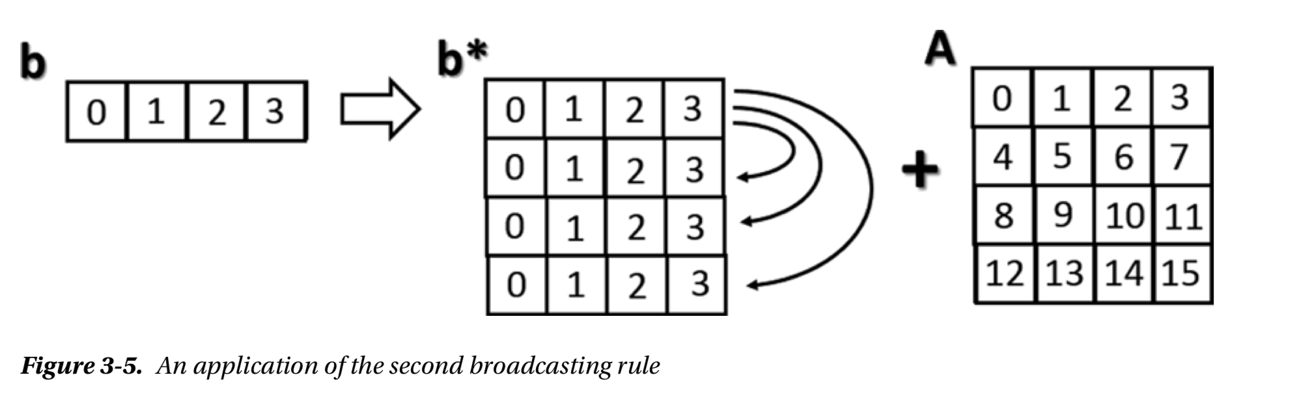
BroadCasting

Slide 36
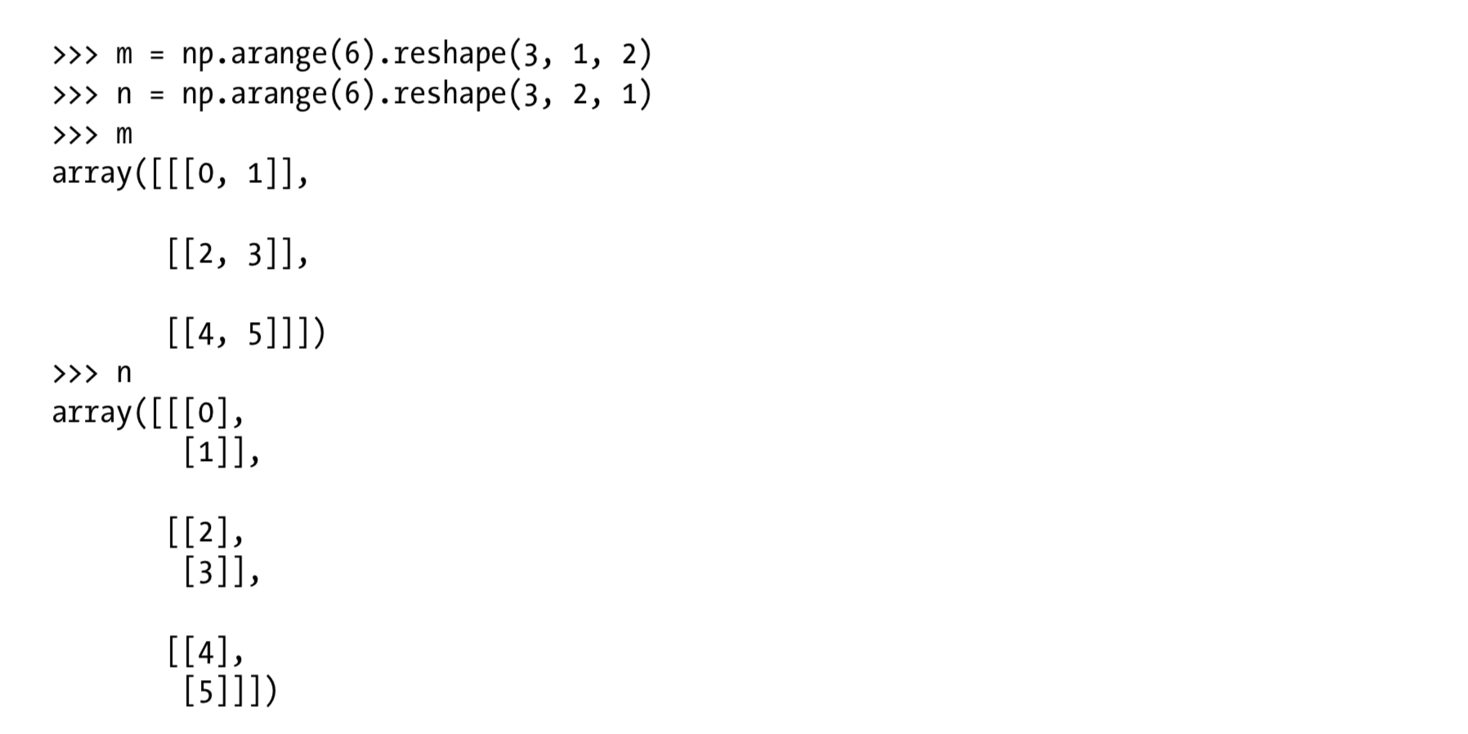
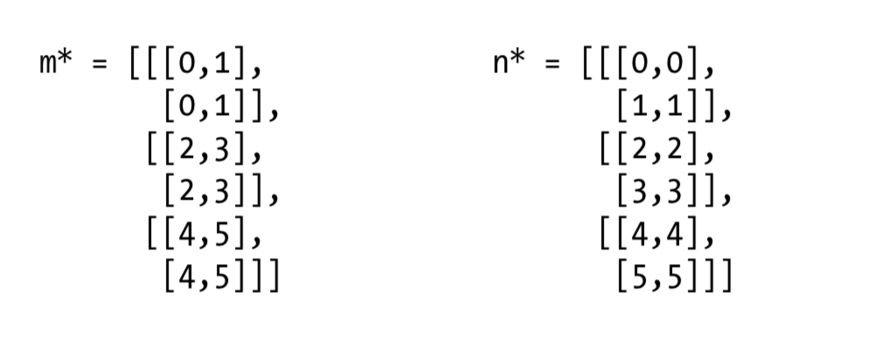
Broadcasted to

Slide 37


Slide 38
Pandas
Pandas is an open-source, BSD-licensed Python library providing high-performance, easy-to-use data structures and data analysis tools for the Python programming language.
Tools for loading data into in-memory data objects from different file formats.
Data alignment and integrated handling of missing data.
Time Series functionality.
High performance merging and joining of data.

Slide 39
Python Pandas - Series
Series is a one-dimensional labeled array capable of holding data of any type (integer, string, float, python objects, etc.). The axis labels are collectively called index.
  pandas.Series( data, index, dtype, copy)
Program
import pandas as pd
import numpy as np
data = np.array(['a','b','c','d'])
s = pd.Series(data,index=[100,101,102,103])
Print( s)

Slide 40
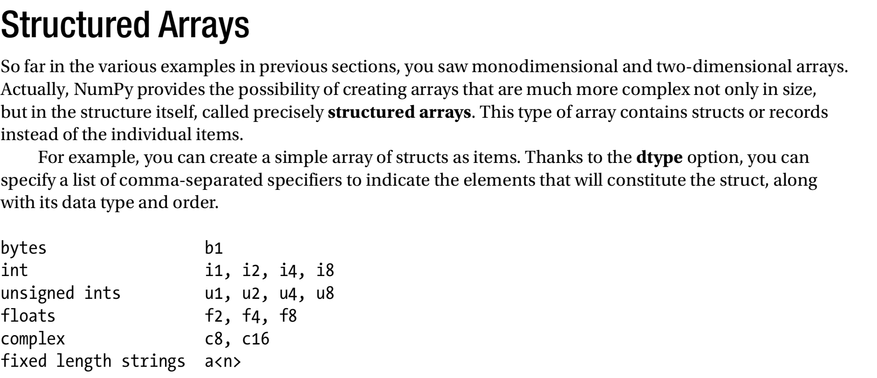

Slide 41
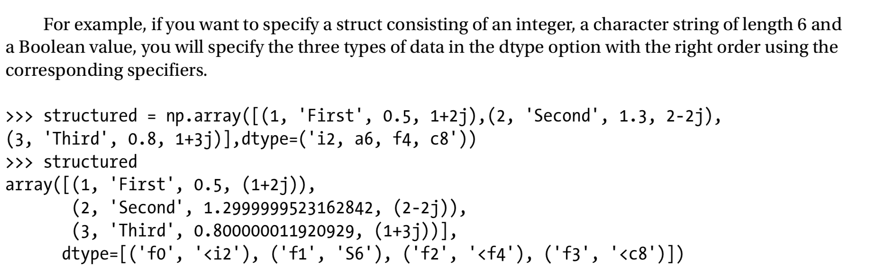

Slide 42
Python Pandas - DataFrame
A Data frame is a two-dimensional data structure, i.e., data is aligned in a tabular fashion in rows and columns.
Features of DataFrame
  Potentially columns are of different types
  Size – Mutable
  Labeled axes (rows and columns)
  Can Perform Arithmetic operations on rows and columns

Slide 43
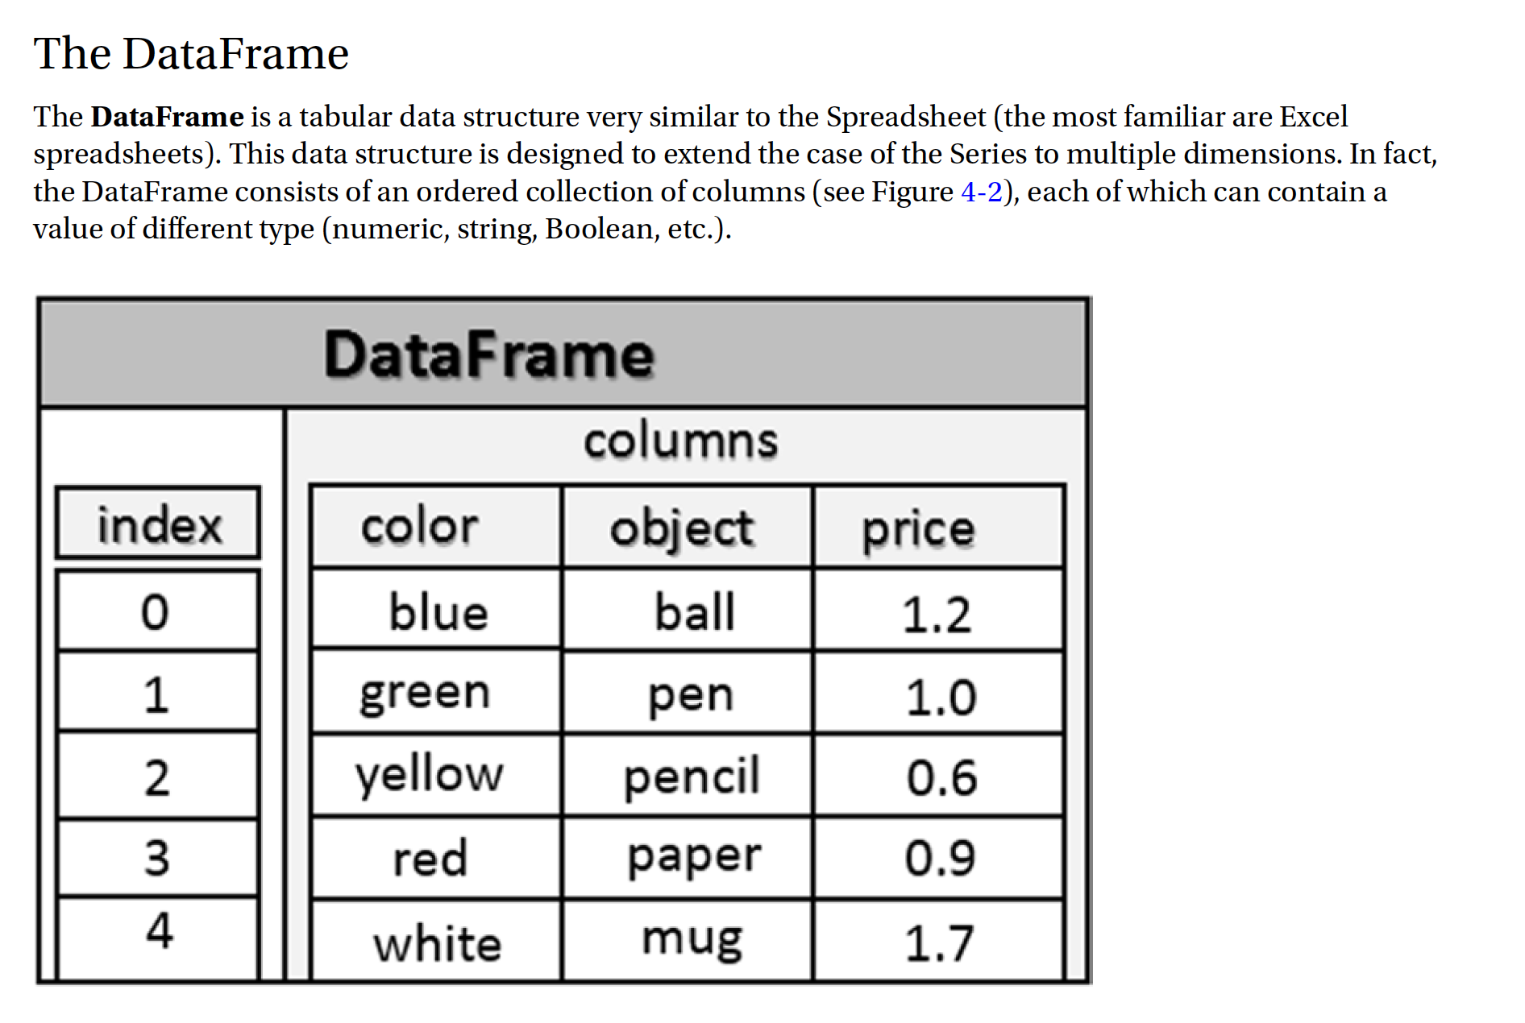
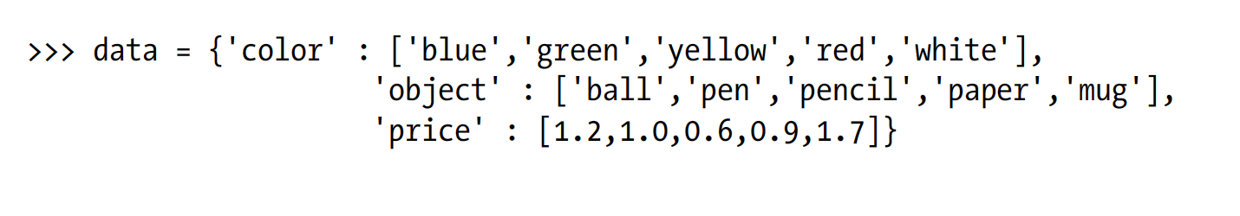

Slide 44
Example
import pandas as pd
data = [['Alex',10],['Bob',12],['Clarke',13]]
df = pd.DataFrame(data,columns=['Name','Age']) print (df)

Slide 45
Create a DataFrame from Dict of Series
import pandas as pd
d = {'one' : pd.Series([1, 2, 3], index=['a', 'b', 'c']), 'two' : pd.Series([1, 2, 3, 4], index=['a', 'b', 'c', 'd'])}
df = pd.DataFrame(d)
print (df)

Slide 46
Column Selection
import pandas as pd
d = {'one' : pd.Series([1, 2, 3], index=['a', 'b', 'c']), 'two' : pd.Series([1, 2, 3, 4], index=['a', 'b', 'c', 'd'])}
df = pd.DataFrame(d)
print df ['one']

Slide 47
Column Addition
import pandas as pd
d = {'one' : pd.Series([1, 2, 3], index=['a', 'b', 'c']), 'two' : pd.Series([1, 2, 3, 4], index=['a', 'b', 'c', 'd'])}
df = pd.DataFrame(d)
# Adding a new column to an existing DataFrame object with column label by passing new series
print ("Adding a new column by passing as Series:")
df['three']=pd.Series([10,20,30],index=['a','b','c'])
print (df)
print ("Adding a new column using the existing columns in DataFrame:")
df['four']=df['one']+df['three']
print (df)

Slide 48
Column Deletion
import pandas as pd
d = {'one' : pd.Series([1, 2, 3], index=['a', 'b', 'c']), 'two' : pd.Series([1, 2, 3, 4], index=['a', 'b', 'c', 'd']), 'three' : pd.Series([10,20,30], index=['a','b','c'])}
df = pd.DataFrame(d)
print ("Our dataframe is:")
print (df)
# using del function
print ("Deleting the first column using DEL function:")
del df['one']
print (df)
# using pop function
print ("Deleting another column using POP function:") df.pop('two')
print (df)

Slide 49
Row Selection, Addition, and Deletion
Rows can be selected by passing row label to a loc function.
Program
import pandas as pd
d = {'one' : pd.Series([1, 2, 3], index=['a', 'b', 'c']), 'two' : pd.Series([1, 2, 3, 4], index=['a', 'b', 'c', 'd'])}
df = pd.DataFrame(d)
Print( df.loc['b'])

Slide 50
Selection by integer location
Rows can be selected by passing integer location to an iloc function.
Program
import pandas as pd
d = {'one' : pd.Series([1, 2, 3], index=['a', 'b', 'c']), 'two' : pd.Series([1, 2, 3, 4], index=['a', 'b', 'c', 'd'])}
df = pd.DataFrame(d)
print( df.iloc[2])

Slide 51
Slice Rows
Multiple rows can be selected using ‘ : ’ operator.
Program
import pandas as pd
d = {'one' : pd.Series([1, 2, 3], index=['a', 'b', 'c']), 'two' : pd.Series([1, 2, 3, 4], index=['a', 'b', 'c', 'd'])}
df = pd.DataFrame(d)
print (df[2:4])

Slide 52
Addition of Rows
Add new rows to a DataFrame using the append function.
Program
import pandas as pd
df = pd.DataFrame([[1, 2], [3, 4]], columns = ['a','b'])
df2 = pd.DataFrame([[5, 6], [7, 8]], columns = ['a','b'])
df = df.append(df2)
print (df)

Slide 53
Deletion of Rows
Use index label to delete or drop rows from a DataFrame. If label is duplicated, then multiple rows will be dropped.
Program
import pandas as pd
df = pd.DataFrame([[1, 2], [3, 4]], columns = ['a','b'])
df2 = pd.DataFrame([[5, 6], [7, 8]], columns = ['a','b'])
df = df.append(df2)
# Drop rows with label 0
df = df.drop(0)
print (df)

Slide 54
Python Pandas - IO Tools
The two functions for reading text files (or the flat files) are read_csv() and read_table(). They both use the same parsing code to intelligently convert tabular data into a DataFrame object .
Consider the following temp.csv file
S.No,Name,Age,City,Salary 1,Tom,28,Toronto,20000
2,Lee,32,HongKong,3000
3,Steven,43,Bay Area,8300
4,Ram,38,Hyderabad,3900

Slide 55
read.csv
import pandas as pd df=pd.read_csv("temp.csv")
print (df)

Slide 56
Converters
import pandas as pd
df = pd.read_csv("temp.csv", dtype={'Salary': np.float64})
print (df.dtypes)

Slide 57
header_names
import pandas as pd
df=pd.read_csv("temp.csv", names=['a', 'b', 'c','d','e'])
print (df)

Slide 58
skiprows
import pandas as pd
df=pd.read_csv("temp.csv", skiprows=2)
print (df)

Slide 59
Write to .csv file
import pandas as pd
data = [['Alex',10],['Bob',12],['Clarke',13]]
df = pd.DataFrame(data,columns=['Name','Age']) print (df)
df.to_csv(‘temp.csv’)

Slide 60
Data visualization using Matplotlib
Matplotlib is a plotting library for Python.
Conventionally, the package is imported into the Python script by adding the following statement −
  from matplotlib import pyplot as plt
Here pyplot() is the most important function in matplotlib library, which is used to plot 2D data.

Slide 61
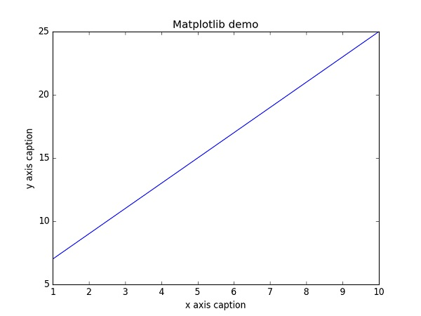
Example: Line Plot
Plot the equation y = 2x + 5
Program
import numpy as np
from matplotlib import pyplot as plt
x = np.arange(1,11)
y = 2 * x + 5
plt.title(“Line Plot")
plt.xlabel("x axis")
plt.ylabel("y axis”)
plt.plot(x,y)
plt.show()

Slide 62
Instead of the linear graph, the values can be displayed discretely by adding a format string to the plot() function.
‘-’: Solid line style
‘- -’: Dashed line style
‘-.’: Dash-dot line style
‘:’: Dotted line style
‘.’: Point marker
‘,’: Pixel marker
'o‘: Circle marker
'v‘: Triangle_down marker
'^‘: Triangle_up marker
'<‘: Triangle_left marker
'>‘:Triangle_right marker
's‘: Square marker
'p‘: Pentagon marker
'*‘: Star marker

Slide 63
The following color abbreviations are also defined.
Character | Color
'b' | Blue
'g' | Green
'r' | Red
'c' | Cyan
'm' | Magenta
'y' | Yellow
'k' | Black
'w' | White

Slide 64
Example
import numpy as np
from matplotlib import pyplot as plt
x = np.arange(1,11)
y = 2 * x + 5
plt.title(“Line Plot")
plt.xlabel("x axis caption")
plt.ylabel("y axis caption")
plt.plot(x,y,"ob")
plt.show()

Slide 65
Sine Wave Plot
import numpy as np
import matplotlib.pyplot as plt
# Compute the x and y coordinates for points on a sine curve
x = np.arange(0, 3 * np.pi, 0.1)
y = np.sin(x)
plt.title("sine wave form")
# Plot the points using matplotlib
plt.plot(x, y)
plt.show()

Slide 66
subplot()
The subplot() function allows you to plot different things in the same figure. In the following script, sine and cosine values are plotted.
Program:
import numpy as np
import matplotlib.pyplot as plt
# Compute the x and y coordinates for points on sine and cosine curves
x = np.arange(0, 3 * np.pi, 0.1)
y_sin = np.sin(x)
y_cos = np.cos(x)
# Set up a subplot grid that has height 2 and width 1,
# and set the first such subplot as active.
plt.subplot(2, 1, 1)
# Make the first plot
plt.plot(x, y_sin)
plt.title('Sine')
# Set the second subplot as active, and make the second plot.
plt.subplot(2, 1, 2)
plt.plot(x, y_cos)
plt.title('Cosine')
# Show the figure.
plt.show()

Slide 67
bar()
The pyplot submodule provides bar() function to generate bar graphs.
Program
from matplotlib import pyplot as plt
x = [5,8,10]
y = [12,16,6]
x2 = [6,9,11]
y2 = [6,15,7]
plt.bar(x, y, align = 'center')
plt.bar(x2, y2, color = 'g', align = 'center') plt.title('Bar graph')
plt.ylabel('Y axis')
plt.xlabel('X axis')
plt.show()

Slide 68
Histogram
NumPy has a numpy.histogram() function that is a graphical representation of the frequency distribution of data. Rectangles of equal horizontal size corresponding to class interval called bin and variable height corresponding to frequency.
Program
import numpy as np
a=np.array([22,87,5,43,56,73,55,54,11,20,51,5,79,31,27])
plt.hist(a, bins = [0,20,40,60,80,100])
plt.title("histogram")
plt.show()

Slide 69
Pie Chart
Pie charts are good to show proportional data of different categories and figures are usually in percentages.
Program
import matplotlib.pyplot as plt
province_population = [12344408, 2441523, 30523371, 110012442, 47886051]
activities = ['Balochistan', 'Gilgit-Baltistan', 'Khyber Pakhtunkhwa', 'Punjab', 'Sindh']
plt.pie(province_population, labels=activities, startangle=90, autopct='%.1f%%')
plt.title('Pakistan Population Province Wise')
plt.show()

Slide 70
scikit
SciPy, pronounced as Sigh Pi, is a scientific python open source, distributed under the BSD licensed library to perform Mathematical, Scientific and Engineering Computations.
The SciPy library depends on NumPy, which provides convenient and fast N-dimensional array manipulation.

Slide 71
SciPy - Cluster
K-means clustering is a method for finding clusters and cluster centers in a set of unlabelled data.
Intuitively, we might think of a cluster as – comprising of a group of data points, whose inter-point distances are small compared with the distances to points outside of the cluster.
Given an initial set of K centers, the K-means algorithm iterates the following two steps −
  For each center, the subset of training points (its cluster) that is closer to it is identified than any other center.
  The mean of each feature for the data points in each cluster are computed, and this mean vector becomes the new center for that cluster.
These two steps are iterated until the centers no longer move or the assignments no longer change.
Then, a new point x can be assigned to the cluster of the closest prototype.

Slide 72
SciPy - Interpolate
Interpolation is the process of finding a value between two points on a line or a curve.
To help us remember what it means, we should think of the first part of the word, 'inter,' as meaning 'enter,' which reminds us to look 'inside' the data we originally had.
Program
import numpy as np
from scipy import interpolate
import matplotlib.pyplot as plt
x = np.linspace(0, 4, 12)
y = np.cos(x**2/3+4)
print (x,y)
plt.plot(x, y,’o’)
plt.show()

Slide 73
SciPy - Ndimage
The SciPy ndimage submodule is dedicated to image processing. Here, ndimage means an n-dimensional image.
Some of the most common tasks in image processing are as follows &miuns;
  Input/Output, displaying images
  Basic manipulations − Cropping, flipping, rotating, etc.
  Image filtering − De-noising, sharpening, etc.
  Image segmentation − Labeling pixels corresponding to different objects
  Classification
  Feature extraction
  Registration

Slide 74
Application of Tensorflow
It’s a powerful machine learning framework
It is used for deep learning.
It helps classify and cluster data like that with sometimes superhuman accuracy.
RankBrain: A large-scale deployment of deep neural nets for search ranking on Google
SmartReply: Deep LSTM model to automatically generate email responses
On-Device Computer Vision for OCR: On-device computer vision model to do optical character recognition to enable real-time translation.
Massively Multitask Networks for Drug Discovery: A deep neural network model for identifying promising drug candidates.

Slide 75
Application of Keras
Keras Applications are deep learning models that are made available alongside pre-trained weights. These models can be used for prediction, feature extraction, and fine-tuning.
Weights are downloaded automatically when instantiating a model.
Models for image classification with weights trained on ImageNet:
  Xception
  VGG16
  VGG19
  ResNet50
  InceptionV3
  InceptionResNetV2
  MobileNet
  DenseNet
  NASNet
  MobileNetV2
Keras has broad adoption in the industry and the research community

Slide 76
Application of Scikit-Learn
Simple and efficient tools for data mining and data analysis
Built on NumPy, SciPy, and matplotlib
Applications:
  Classification: identifying to which category an object belongs to.
  Regression: Predicting a continuous-valued attribute associated with an object.
  Clustering: Automatic grouping of similar objects into sets.
  Dimensionality reduction: Reducing the number of random variables to consider.
  Model Selection: Comparing, validating and choosing parameters and models.
  Preprocessing: Feature extraction and normalization.

Slide 77
Intelligent Systems Track
Soft Computing Techniques
Machine Learning Foundation
Advanced Machine Learning
Pattern Recognition

Slide 78
